Slide 1


The Rising Tide of
VIOLENCE

Slide 2

The Rising Tide of
VIOLENCE
A Call for Unity and Peace
  In the last 25 years, violence in the United States has significantly increased.
  This program explores the factors contributing to this rise, including political polarization and radical groups.
  It also offers a hopeful message: peace starts within us, and we must find common ground to create a positive future.

Slide 3

The Rising Tide of
VIOLENCE
A Call for Unity and Peace
  National homicide rates have risen, especially in cities like Chicago and Baltimore.
  The frequency of mass shootings has escalated dramatically.
  Acts of domestic terrorism have increased, driven by political and ideological motives.

Slide 4
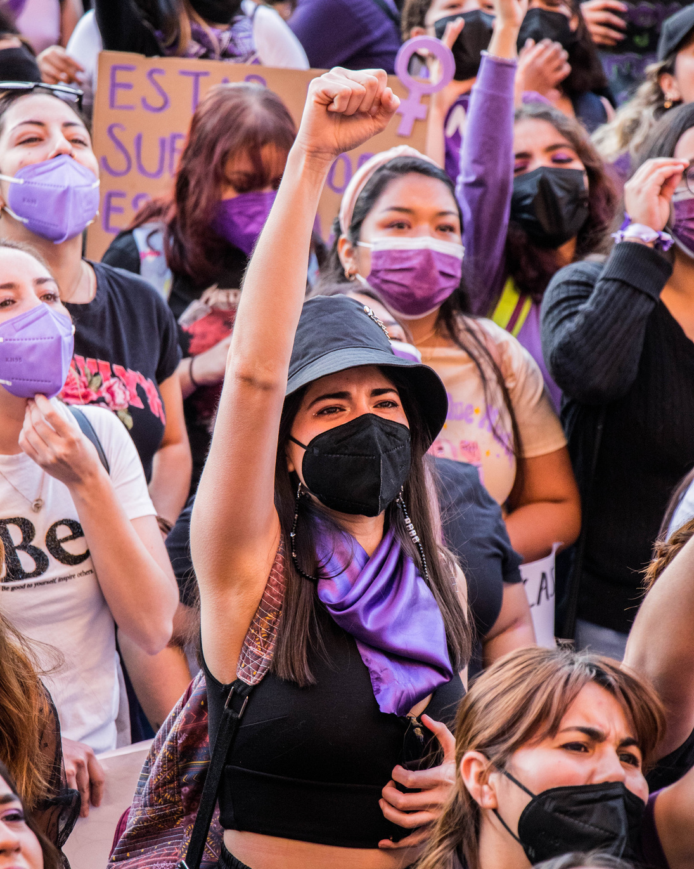
The Rising Tide of
VIOLENCE
A Call for Unity and Peace
  Extreme political groups on both the left and right contribute to a climate of division and hostility.
  Black Lives Matter and Antifa have engaged in protests, some of which turned violent.
  Attacks on American exceptionalism fuel disillusionment and conflict.

Slide 5

The Rising Tide of
VIOLENCE
A Call for Unity and Peace
  Anti-capitalist groups argue that the economic system creates inequality and suffering.
  Environmental extremists like Earth Liberation Front have used arson and sabotage to protest environmental degradation.

Slide 6

The Rising Tide of
VIOLENCE
A Call for Unity and Peace
  True peace begins within each of us through practices like mindfulness and meditation.
  Communities must work towards unity by focusing on shared values and goals.
  Initiatives like community service projects and interfaith dialogues can help bridge divides.

Slide 7

The Rising Tide of
VIOLENCE
A Call for Unity and Peace
  Educate yourself and others about the issues and advocate for better mental health resources.
  Create safe spaces and promote dialogue within communities.
  Implement sensible gun control measures and provide economic support to disadvantaged communities.

Slide 8

The Rising Tide of
VIOLENCE
A Call for Unity and Peace
  The rise in violence over the past 25 years is a complex issue, but by working together, we can create a safer, more peaceful society.
  By finding common ground and fostering unity, we can build a positive future for ourselves and our children.
  Let us commit to this journey for a better world.

Slide 9

The Rising Tide of
VIOLENCE
What Can We Do to Reduce the Rampant Violence in Our Society?
Renowned celebrities and experts, including Dr. Billy Graham, Art Linkletter, Dr. Bettie B. Youngs, Erik Olesen, Dr. Stephen R. Covey, Zig Ziglar, Dr. Stan Dale, Alan Cohen, Dottie Walters, Robert W. Reasoner, John Goddard, Miryam Mallin-Dubin, and Steven P. Hadar, have contributed invaluable insights and solutions to these pressing issue.

Slide 10

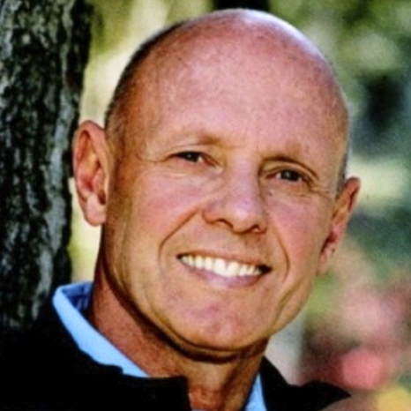
DR. STEPHEN R. COVEY'S MESSAGE
Insights and Actionable Strategies
PROMOTING FAMILY STABILITY
  Importance: Strong family values are crucial for reducing violence.
  Action: Encourage conflict resolution and effective communication within families.
  Implementation: Organize community workshops and establish support groups for families.

Slide 11
DR. STEPHEN R. COVEY'S MESSAGE
Insights and Actionable Strategies
PERSONAL CHARACTER DEVELOPMENT
  Importance: Personal responsibility and self-improvement are key to non-violent behavior.
  Action: Model non-violent behavior and encourage self-improvement.
  Implementation: Implement educational programs in schools and communities focused on emotional intelligence and non-violent conflict resolution.

Slide 12
DR. STEPHEN R. COVEY'S MESSAGE
Insights and Actionable Strategies
MANAGING MEDIA INFLUENCE
  Importance: Reducing exposure to violent media can decrease violent behavior.
  Action: Educate the public on the impact of violent media and promote positive content.
  Implementation: Launch media literacy campaigns and collaborate with local media to increase positive content.

Slide 13
DR. STEPHEN R. COVEY'S MESSAGE
Insights and Actionable Strategies
ENCOURAGING COMMUNITY INVOLVEMENT
  Importance: Community support is essential for reducing violence.
  Action: Foster community bonding and provide platforms for constructive activities.
  Implementation: Organize community events, promote mentorship programs, and establish safe spaces for discussions and activities.

Slide 14

DR. STAN DALE'S MESSAGE
Insights and Actionable Strategies
IMPORTANCE OF ANGER MANAGEMENT
  Significance: Managing anger is crucial to preventing violent outbursts.
  Action: Teach recognition and control of anger.
  Implementation: Offer anger management workshops and stress relief programs in community centers.

Slide 15
DR. STAN DALE'S MESSAGE
Insights and Actionable Strategies
FOSTERING LOVE OVER VIOLENCE
  Significance: Promoting love and positive emotions can reduce violent tendencies.
  Action: Encourage expressions of love and care in daily interactions.
  Implementation: Organize community events and create support networks to build positive emotional connections.

Slide 16
DR. STAN DALE'S MESSAGE
Insights and Actionable Strategies
DEVELOPING POSITIVE HABITS
  Significance: Positive habits can replace violent behaviors.
  Action: Promote the development of new, positive habits.
  Implementation: Implement behavioral coaching and educational campaigns focused on positive habit formation.

Slide 17
DR. STAN DALE'S MESSAGE
Insights and Actionable Strategies
PERSONAL RESPONSIBILITY AND EMOTIONAL MATURITY
  Significance: Emotional maturity and personal responsibility are key to non-violent behavior.
  Action: Encourage individuals to take responsibility for their emotions and actions.
  Implementation: Provide educational programs that teach personal responsibility, emotional intelligence, and non-violent conflict resolution.

Slide 18
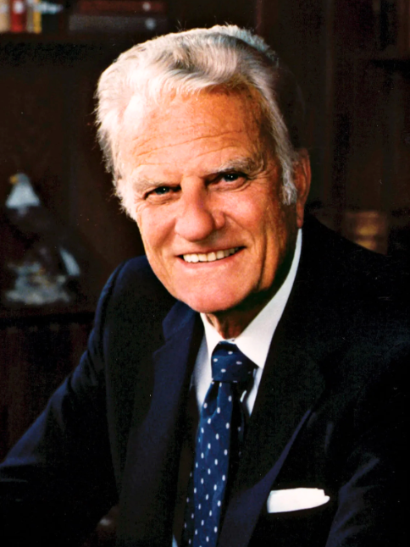
DR. BILLY GRAHAM'S MESSAGE
Insights and Actionable Strategies
EMBRACING SPIRITUAL SOLUTIONS
  Significance: Spiritual growth and guidance can lead to a more peaceful society.
  Action: Encourage personal spiritual growth and promote religious teachings that advocate peace and love.
  Implementation: Organize religious programs and study groups that focus on non-violence and compassion.

Slide 19
DR. BILLY GRAHAM'S MESSAGE
Insights and Actionable Strategies
PROMOTING MORAL VALUES
  Significance: Strong moral values are essential for reducing violence.
  Action: Reinforce the importance of integrity, honesty, and respect in daily life.
  Implementation: Implement moral education programs in schools and launch public campaigns promoting ethical behavior.

Slide 20
DR. BILLY GRAHAM'S MESSAGE
Insights and Actionable Strategies
ENCOURAGING ACTS OF KINDNESS
  Significance: Small acts of kindness can have a significant impact on reducing violence.
  Action: Promote kindness and positive actions toward others.
  Implementation: Organize community service projects and create initiatives that challenge individuals to perform daily acts of kindness.

Slide 21
DR. BILLY GRAHAM'S MESSAGE
Insights and Actionable Strategies
CREATING A SUPPORTIVE ENVIRONMENT
  Significance: A supportive and nurturing environment can deter violent behavior.
  Action: Encourage communities to provide emotional and spiritual support.
  Implementation: Establish support groups and counseling services that offer guidance and promote non-violent conflict resolution.

Slide 22
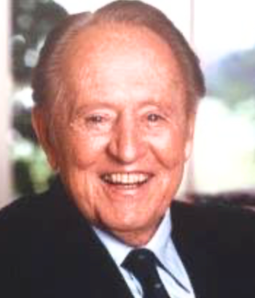
ART LINKLETTER'S MESSAGE
Insights and Actionable Strategies
TRANSFORMING PERSONAL TRAGEDY
  Significance: Personal experiences can fuel meaningful advocacy and change.
  Action: Use personal stories to raise awareness and motivate others.
  Implementation: Share impactful personal narratives in public speaking engagements and counseling sessions.

Slide 23
ART LINKLETTER'S MESSAGE
Insights and Actionable Strategies
ADDRESSING DRUG ABUSE
  Significance: Combating drug abuse is crucial to reducing violence.
  Action: Educate communities about the dangers of drugs and support anti-drug movements.
  Implementation: Organize educational campaigns and support groups for families affected by drug abuse.

Slide 24
ART LINKLETTER'S MESSAGE
Insights and Actionable Strategies
MANAGING ANGER AND GUILT
  Significance: Constructively managing anger and guilt can prevent further violence.
  Action: Transform negative emotions into positive actions.
  Implementation: Provide workshops on anger management and emotional resilience.

Slide 25
ART LINKLETTER'S MESSAGE
Insights and Actionable Strategies
ENCOURAGING COMMUNITY INVOLVEMENT
  Significance: Community support and involvement are essential for reducing violence.
  Action: Foster community engagement and personal responsibility in combating violence.
  Implementation: Create volunteer opportunities and support networks that encourage active community participation.

Slide 26

ERIK OLESEN'S MESSAGE
Insights and Actionable Strategies
REDUCING MEDIA INFLUENCE ON VIOLENCE
  Significance: Exposure to violent media increases aggression in children.
  Action: Limit children's exposure to violent television and movies.
  Implementation: Offer parental guidance workshops and launch campaigns promoting positive media content.

Slide 27
ERIK OLESEN'S MESSAGE
Insights and Actionable Strategies
ADDRESSING UNEMPLOYMENT
  Significance: High unemployment rates contribute to youth violence.
  Action: Create job opportunities and provide support for teenagers.
  Implementation: Partner with local businesses to create job programs and offer job training workshops.

Slide 28
ERIK OLESEN'S MESSAGE
Insights and Actionable Strategies
PROVIDING CONSTRUCTIVE OUTLETS FOR YOUTH
  Significance: Constructive activities can prevent violent behavior
  Action: Engage youth in physical and creative activities.
  Implementation: Develop community programs that offer sports, arts, and other recreational activities.
.

Slide 29
ERIK OLESEN'S MESSAGE
Insights and Actionable Strategies
MANAGING ANGER AND RESENTMENT
  Significance: Healthy management of anger and resentment is crucial for reducing violence.
  Action: Promote healthy ways to release and manage anger.
  Implementation: Establish support groups and offer therapeutic activities such as counseling and sports.
.

Slide 30
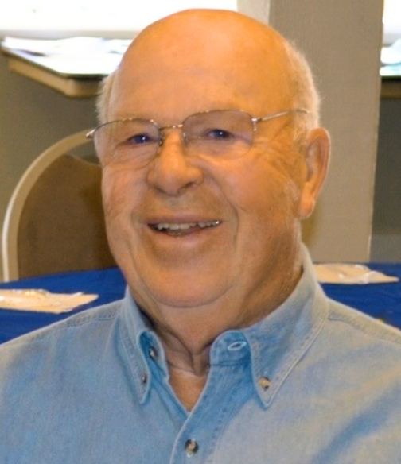
ROBERT W. REASONER'S MESSAGE
Insights and Actionable Strategies
STRENGTHENING FAMILY STRUCTURE
  Significance: Strong family bonds are crucial in preventing youth violence.
  Action: Promote family stability and provide emotional support to children.
  Implementation: Conduct family workshops and establish networks for sharing experiences and guidance.
.

Slide 31
ROBERT W. REASONER'S MESSAGE
Insights and Actionable Strategies
ADDRESSING EMOTIONAL NEEDS
  Significance: Many violent youths lack attention, love, and guidance, leading to low self-esteem and violent reactions.
  Action: Provide emotional support and bonding opportunities with adults.
  Implementation: Develop community programs that offer mentorship and recreational activities.
.

Slide 32
ROBERT W. REASONER'S MESSAGE
Insights and Actionable Strategies
EARLY INTERVENTION AND COUNSELING
  Significance: Early intervention can prevent the escalation of antisocial behaviors.
  Action: Offer counseling and support for children displaying early signs of violence.
  Implementation: Provide accessible counseling services and training programs for parents and caregivers.
.

Slide 33
ROBERT W. REASONER'S MESSAGE
Insights and Actionable Strategies
COMMUNITY PROGRAMS FOR ADOLESCENTS
  Significance: Engaging adolescents in healthy activities can deter violent behavior.
  Action: Create programs that offer sports, arts, and other recreational activities.
  Implementation: Establish community centers that provide safe spaces for adolescents to engage in constructive activities.
.

Slide 34

DR. BETTIE B. YOUNGS’ MESSAGE
Insights and Actionable Strategies
IMPORTANCE OF FAMILY WELLNESS
  Significance: Family wellness is foundational to preventing violence.
  Action: Monitor and support the wellness of families to address dysfunction.
  Implementation: Implement programs that support family wellness and provide counseling services.
.

Slide 35
DR. BETTIE B. YOUNGS’ MESSAGE
Insights and Actionable Strategies
PROMOTING GOODNESS AND COMPASSION
  Significance: Highlighting positive stories fosters a compassionate society.
  Action: Share and promote stories of goodness and compassion within families.
  Implementation: Launch storytelling campaigns and create platforms for sharing positive family narratives.
.

Slide 36
DR. BETTIE B. YOUNGS’ MESSAGE
Insights and Actionable Strategies
DEVELOPING INNER WHOLENESS
  Significance: Inner wholeness leads to a more peaceful and purposeful outer life.
  Action: Help children develop a sense of inner wholeness and purpose.
  Implementation: Provide educational programs focused on emotional intelligence and personal development.
.

Slide 37
DR. BETTIE B. YOUNGS’ MESSAGE
Insights and Actionable Strategies
CREATING SUPPORTIVE ENVIRONMENTS
  Significance: Supportive environments help individuals thrive and reduce violence.
  Action: Foster environments that nourish and support individuals' growth.
  Implementation: Establish community initiatives that create supportive and nurturing environments for families and children.
.

Slide 38
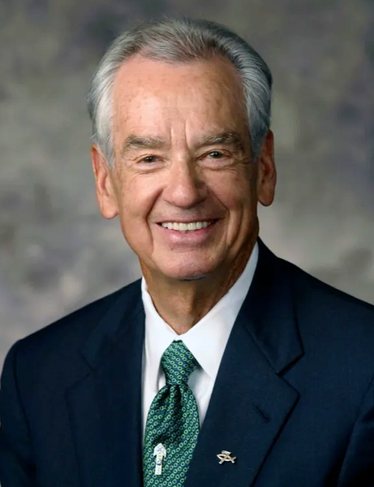
ZIG ZIGLAR’S MESSAGE
Insights and Actionable Strategies
PARENTAL INVOLVEMENT
  Significance: Active parental involvement is crucial in preventing substance abuse and violence.
  Action: Encourage parents to engage actively in their children's lives.
  Implementation: Offer parenting workshops that emphasize the importance of involvement and effective parenting practices.
.

Slide 39
ZIG ZIGLAR’S MESSAGE
Insights and Actionable Strategies
SETTING A POSITIVE EXAMPLE
  Significance: Parents must model positive behaviors for their children.
  Action: Parents should demonstrate healthy lifestyle choices and ethical behavior.
  Implementation: Create programs that help parents understand the impact of their behavior on their children.
.

Slide 40
ZIG ZIGLAR’S MESSAGE
Insights and Actionable Strategies
EDUCATING ABOUT SUBSTANCE ABUSE
  Significance: Education about the dangers of drugs and alcohol is essential for prevention.
  Action: Implement comprehensive drug and alcohol education programs.
  Implementation: Launch educational campaigns in schools and communities to raise awareness about substance abuse.
.

Slide 41
ZIG ZIGLAR’S MESSAGE
Insights and Actionable Strategies
CREATING A SUPPORTIVE HOME ENVIRONMENT
  Significance: A loving and supportive home environment deters substance abuse and violence.
  Action: Foster a nurturing and stress-free home atmosphere.
  Implementation: Provide family support services and stress reduction programs to help families create positive home environments.
.

Slide 42
THANK YOU!

